Slide 1
England's dwelling stock
Sara amini
Emrys duclos
Tiffany Tran-Heinerich

Slide 2
background
• Country context/Research questions
• Challenges/unique features uncovered in Seminar 1

Slide 3
methods
Model development (focus on energy use)

Slide 4
methods
Model development (focus on energy use)

Slide 5
Calibration and validation

Slide 6
Calibration and validation

Slide 7
Scenario 1
Storylines and modeling, Energy results and interpretation

Slide 8
Scenario 2
Storylines and modeling, Energy results and interpretation

Slide 9
Scenario 3
Storylines and modeling, Energy results and interpretation

Slide 10
Conclusions and outlook
Robustness, conclusions, limitations, policy implications

Slide 11
England's dwelling stock
Emrys duclos
Tiffany Tran-Heinerich

Slide 12
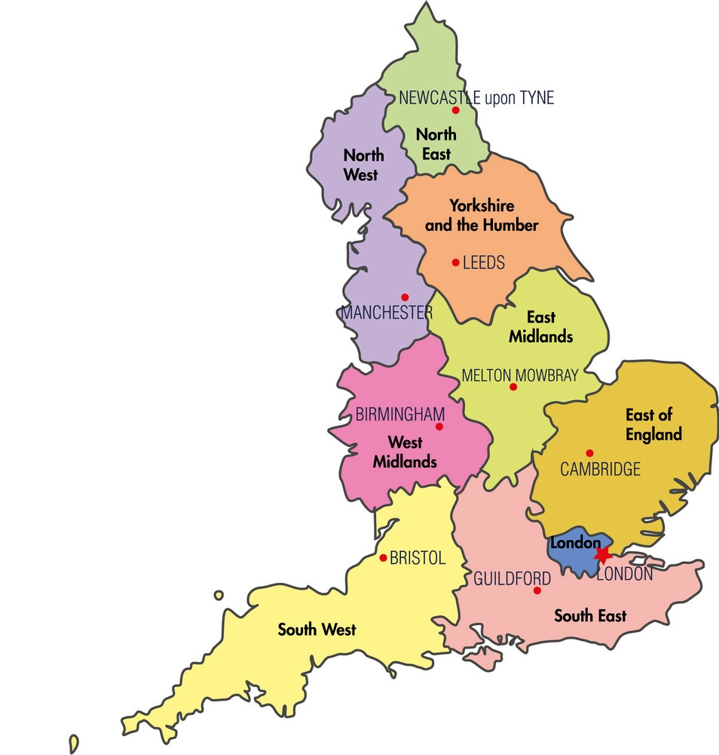
Agenda
Contextualization
Current status of dwelling stock
Energy efficiency
Modelling: historic dwelling stock
Modelling: future projections

Slide 13
Context
Population
And Legislation

Slide 14
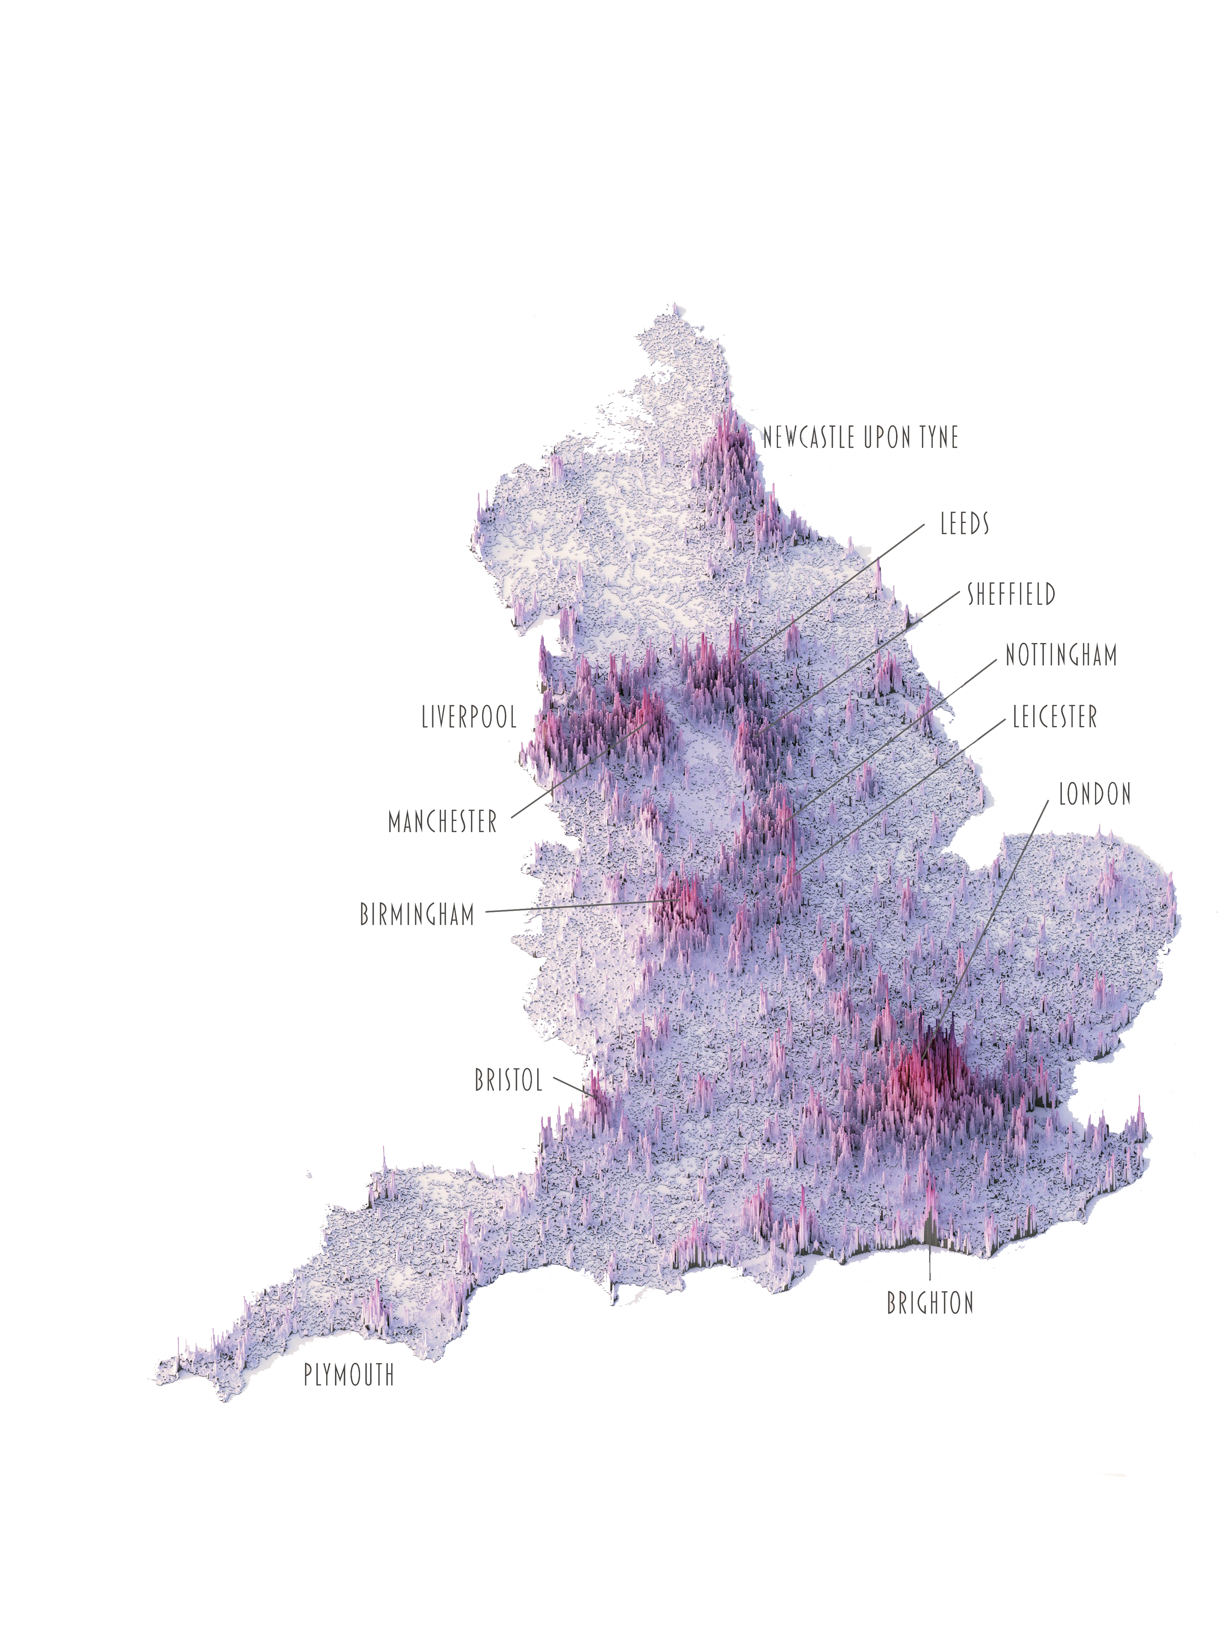
Context
Total pop: ca. 56 million
London pop: ca. 9 million
25 million dwellings
England => part of UK
=> datasets are not always clear

Slide 15

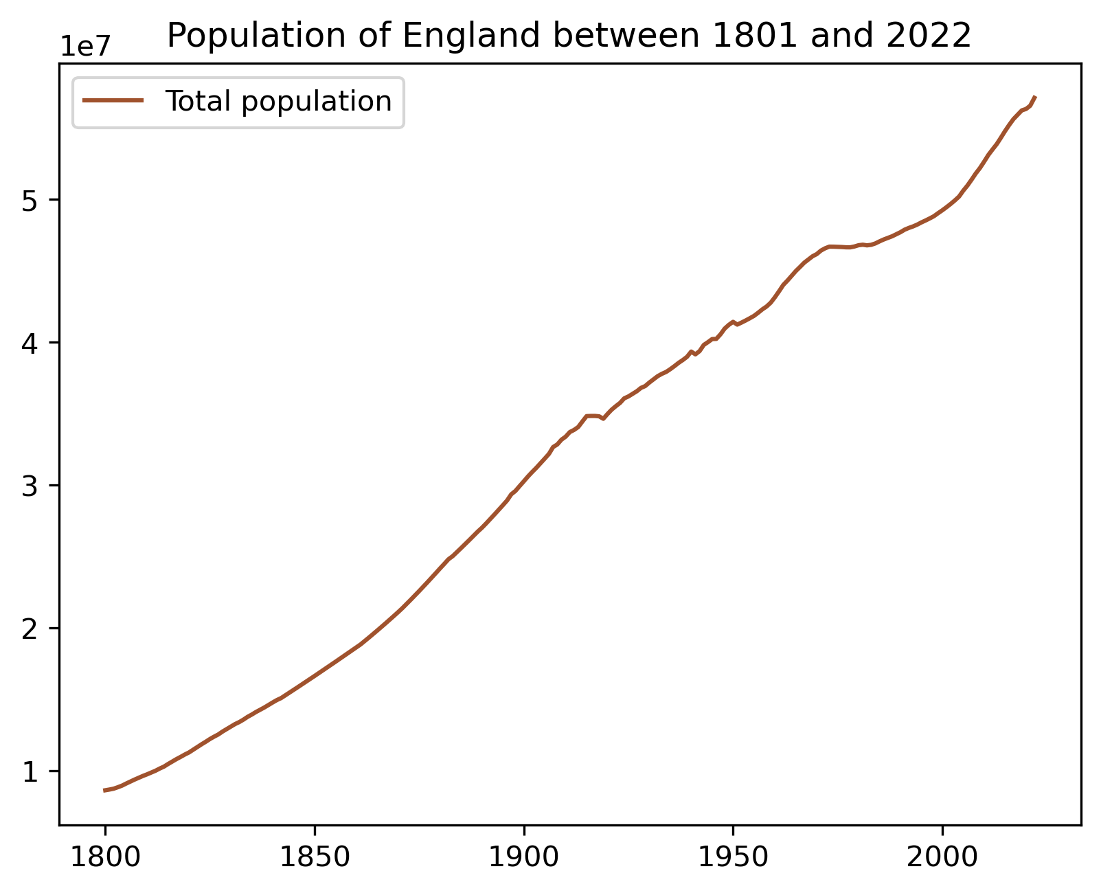
*two data sources crossed

Slide 16
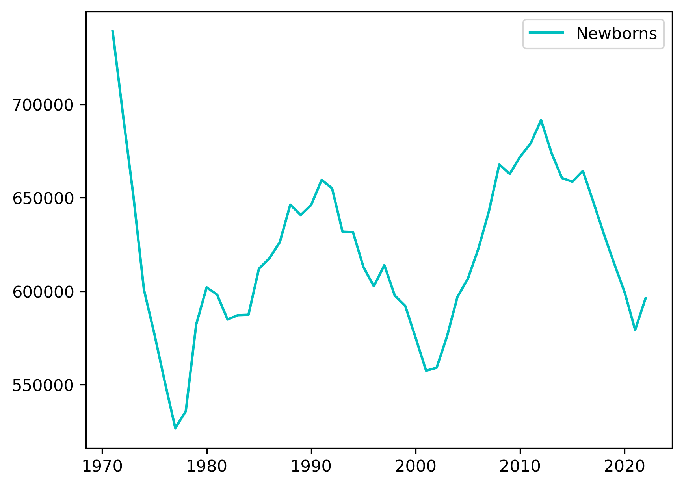

Slide 17
Building regulations in the uk (England+Wales)
The Building Act 1984 is giving the big frame for construction process, design and specifications.
The latest updates concern:
"Security" (2015)
"High Speed Broadband Infrastructure" (2017)
"Overheating" (2022)
The Climate Change and Sustainable Energy Act 2006 adds new regulations regarding energy.
The goal is to boost the number of heat and electricity microgeneration
Wind turbines
Ground source heat pumps
Solar electricity

Slide 18
Current status of dwelling stock
Stock evolution
Occupancy
Vacancy
Decency

Slide 19
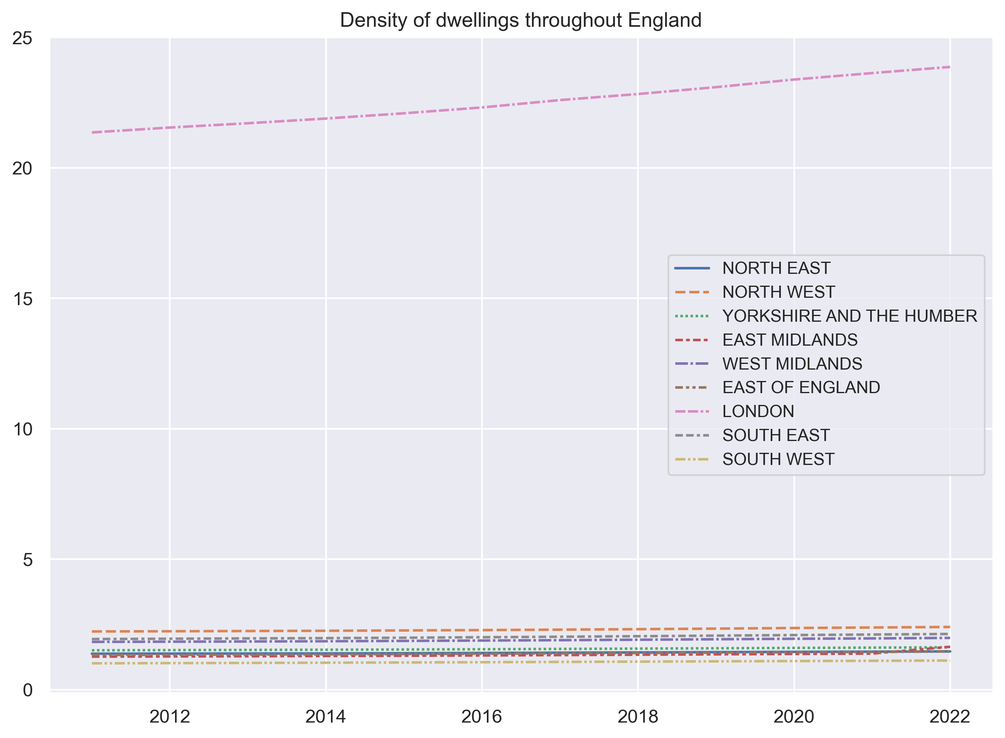

Slide 20
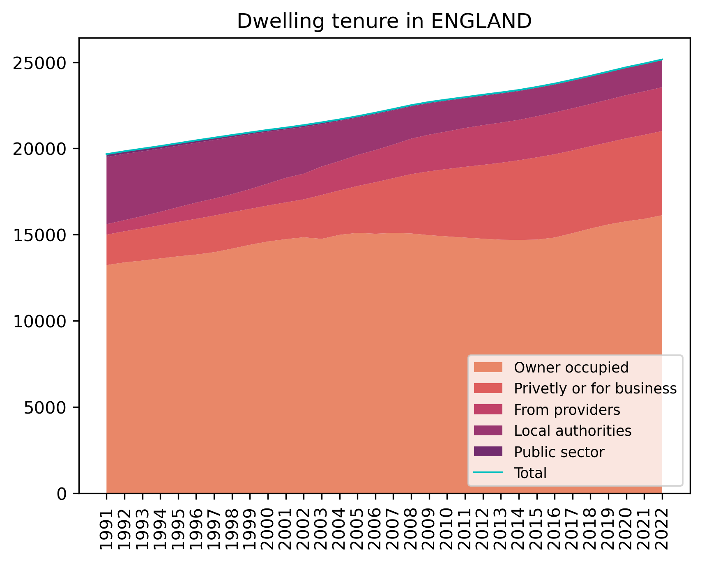

Slide 21
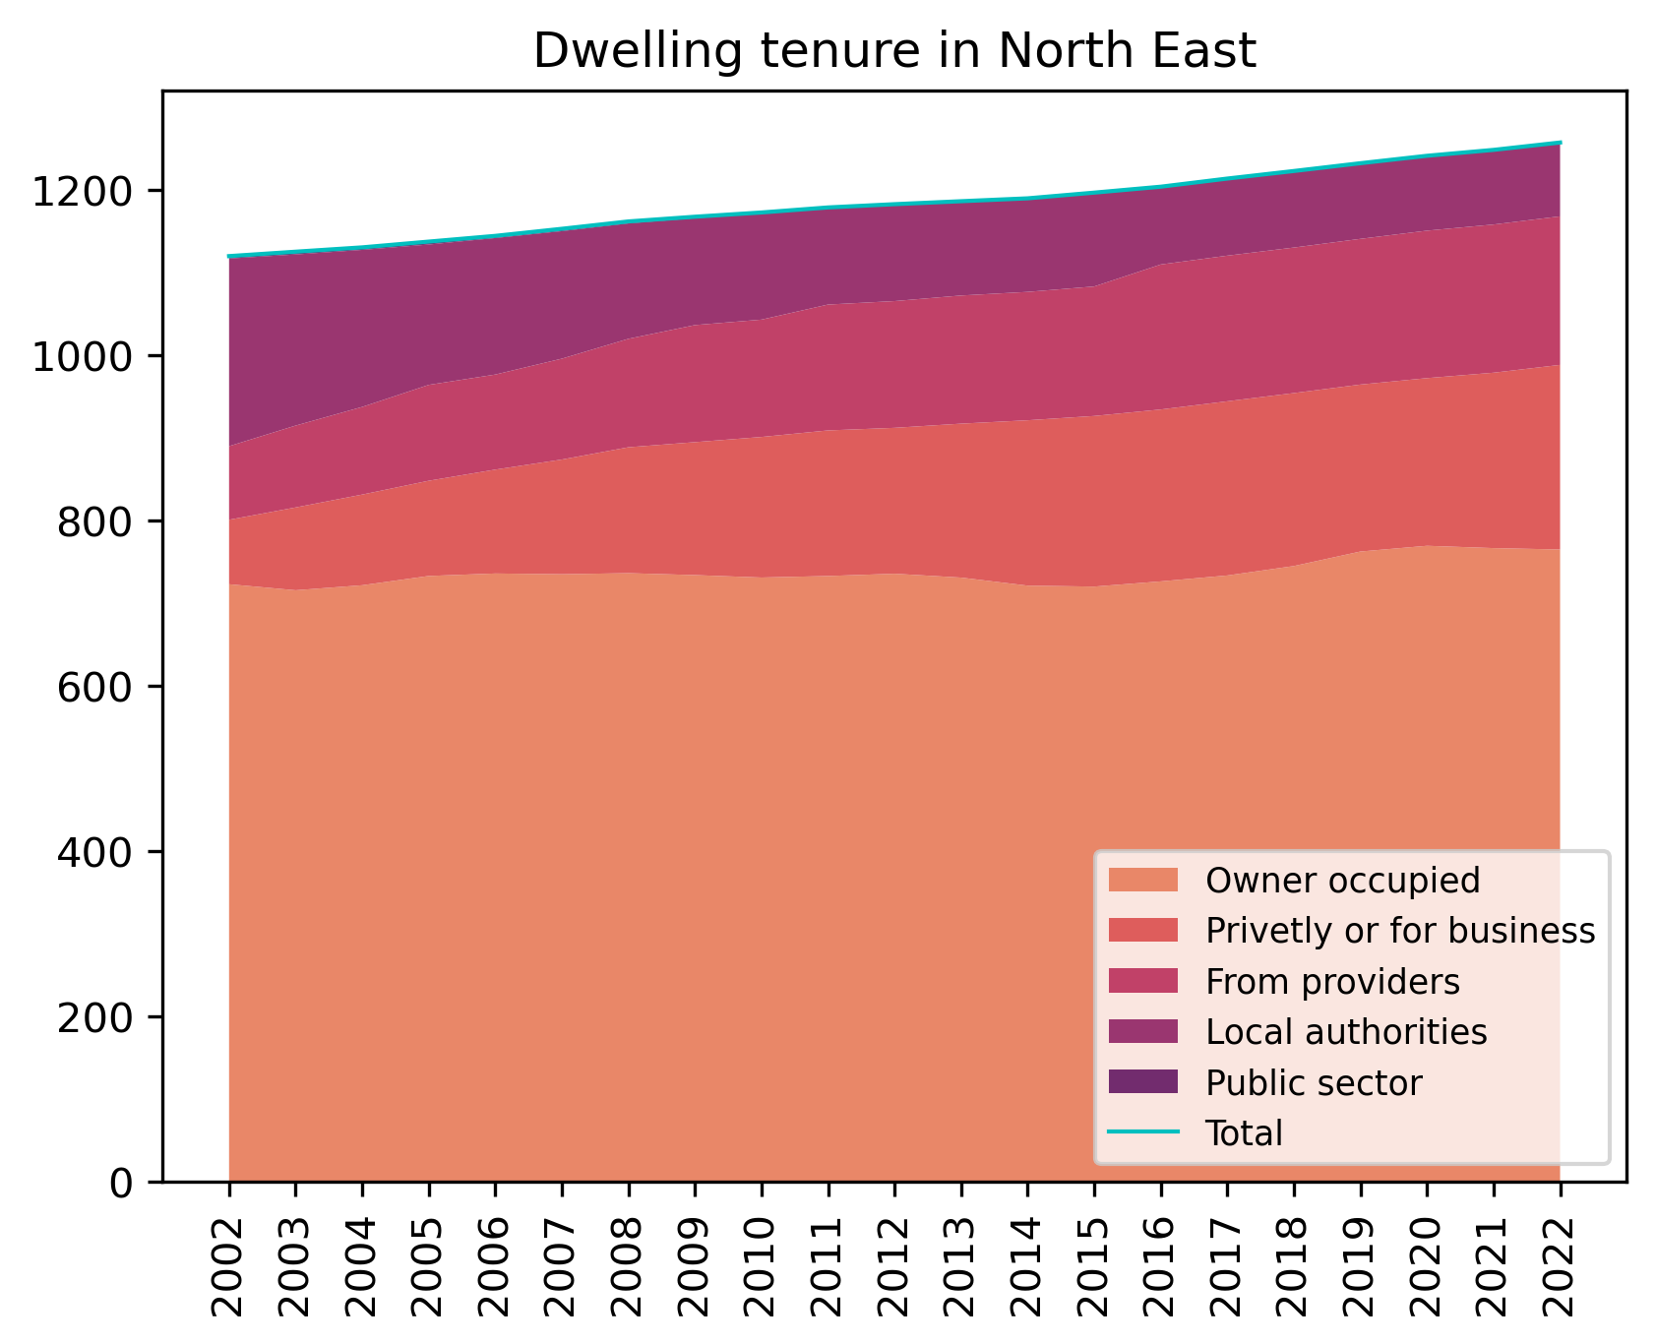
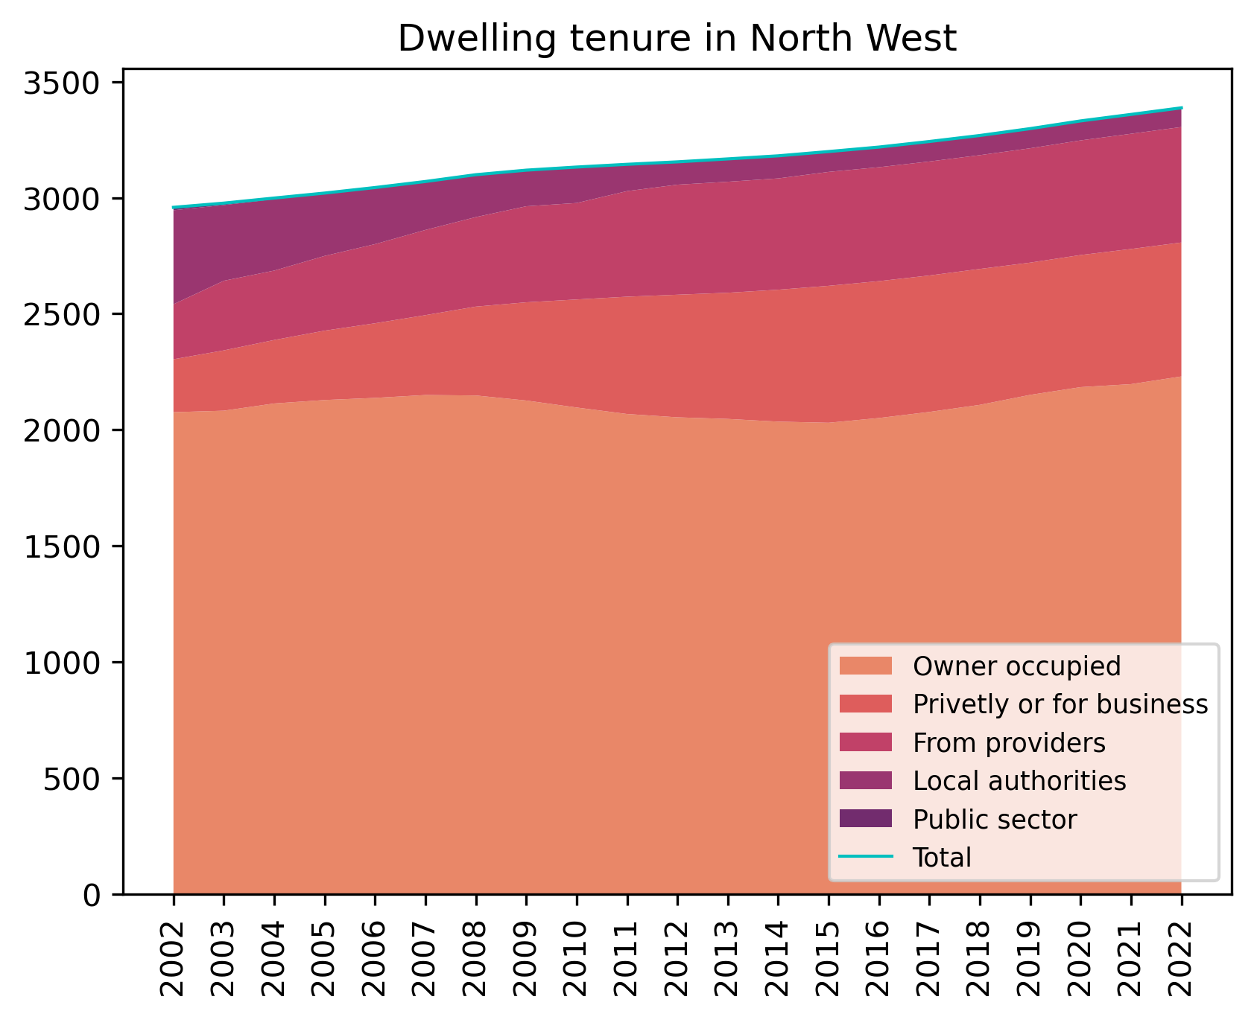
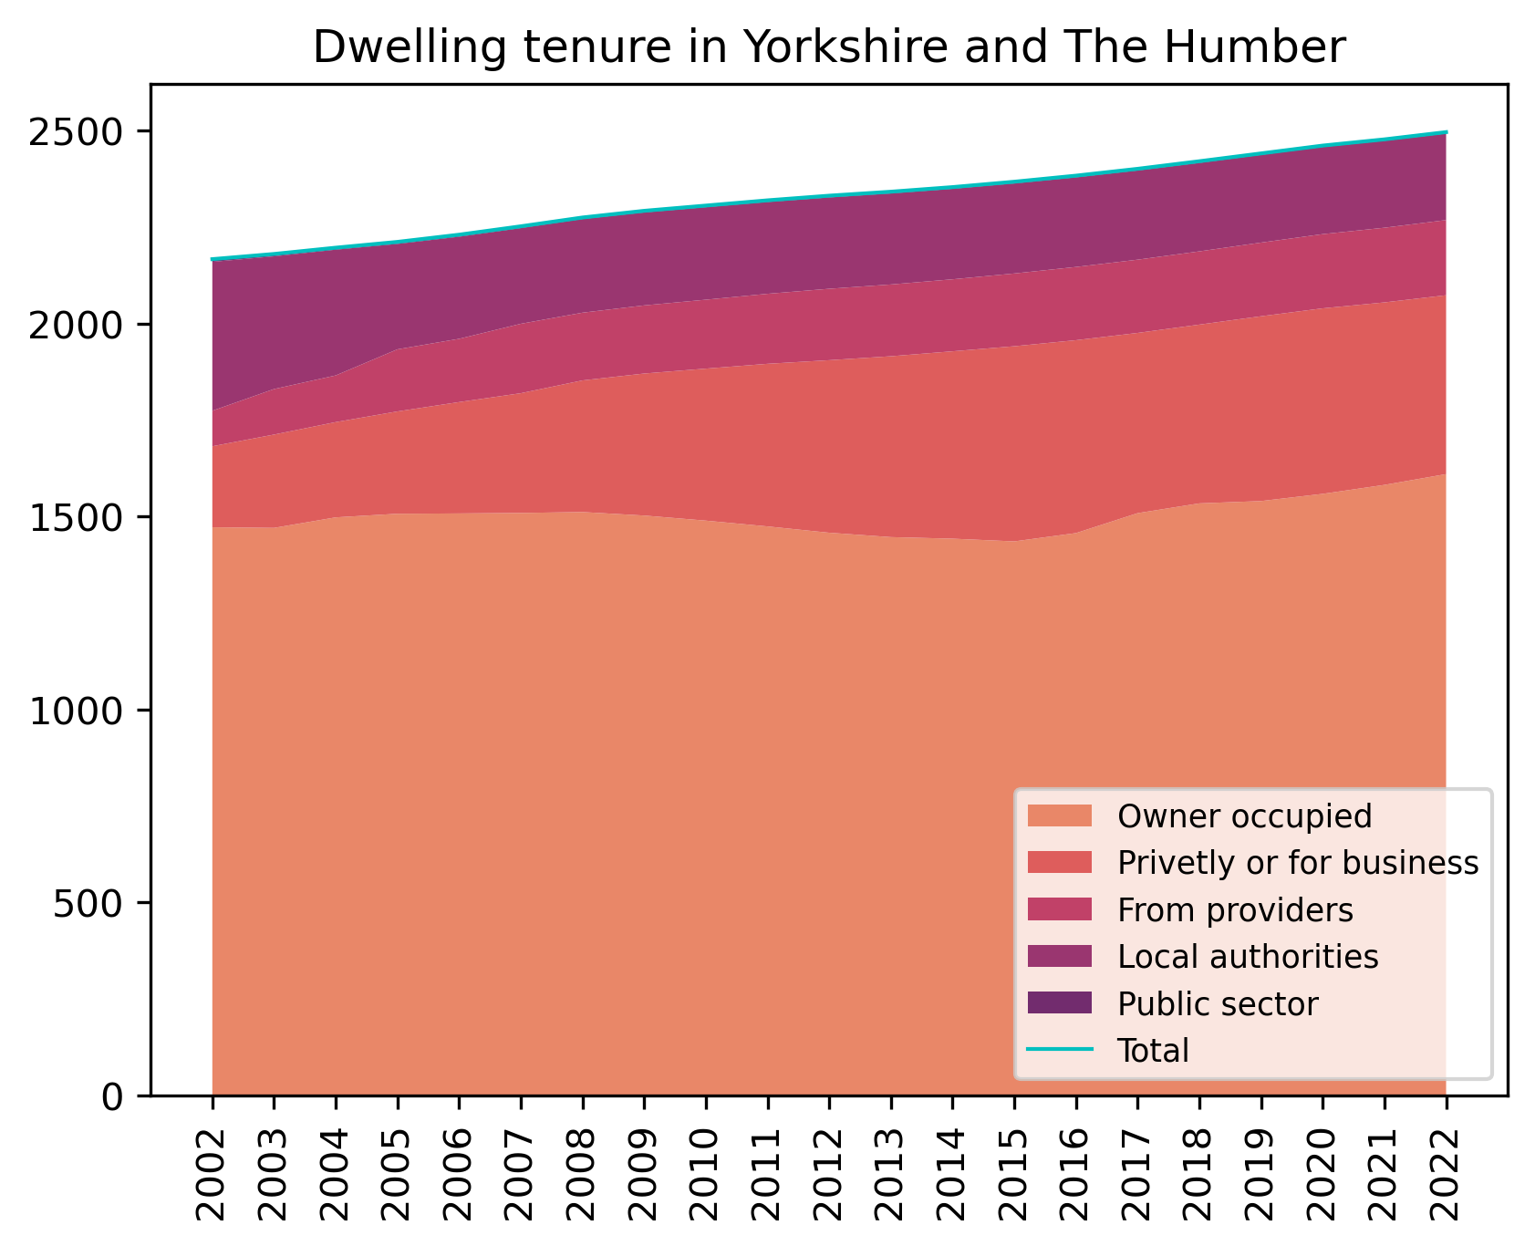
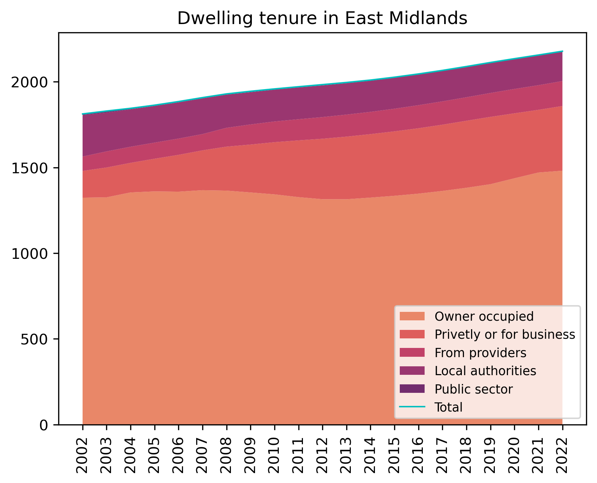


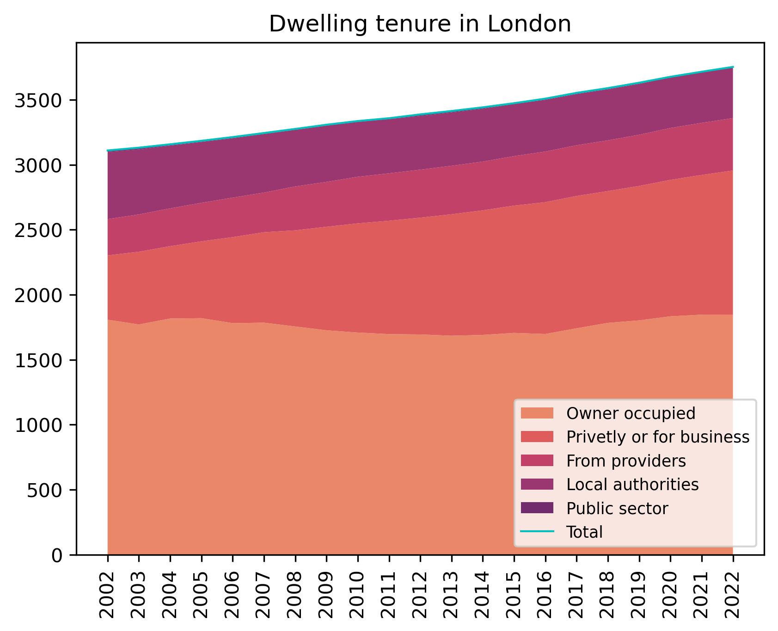
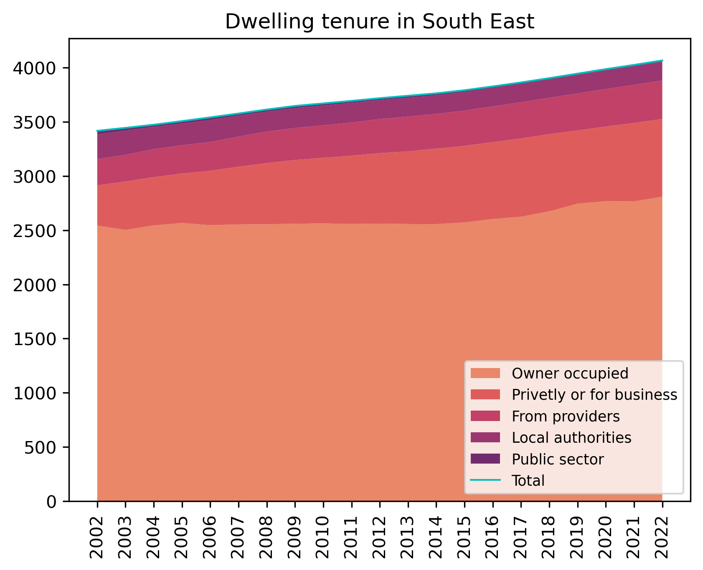

Dwelling by tenure, by region
[ thousands of dwellings ]

Slide 22
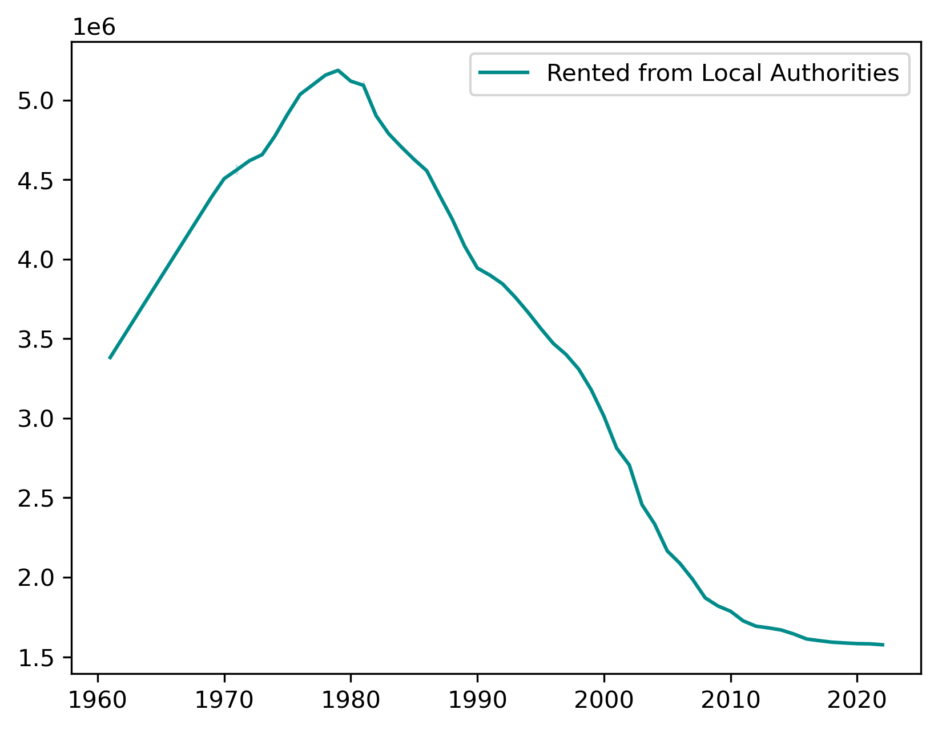
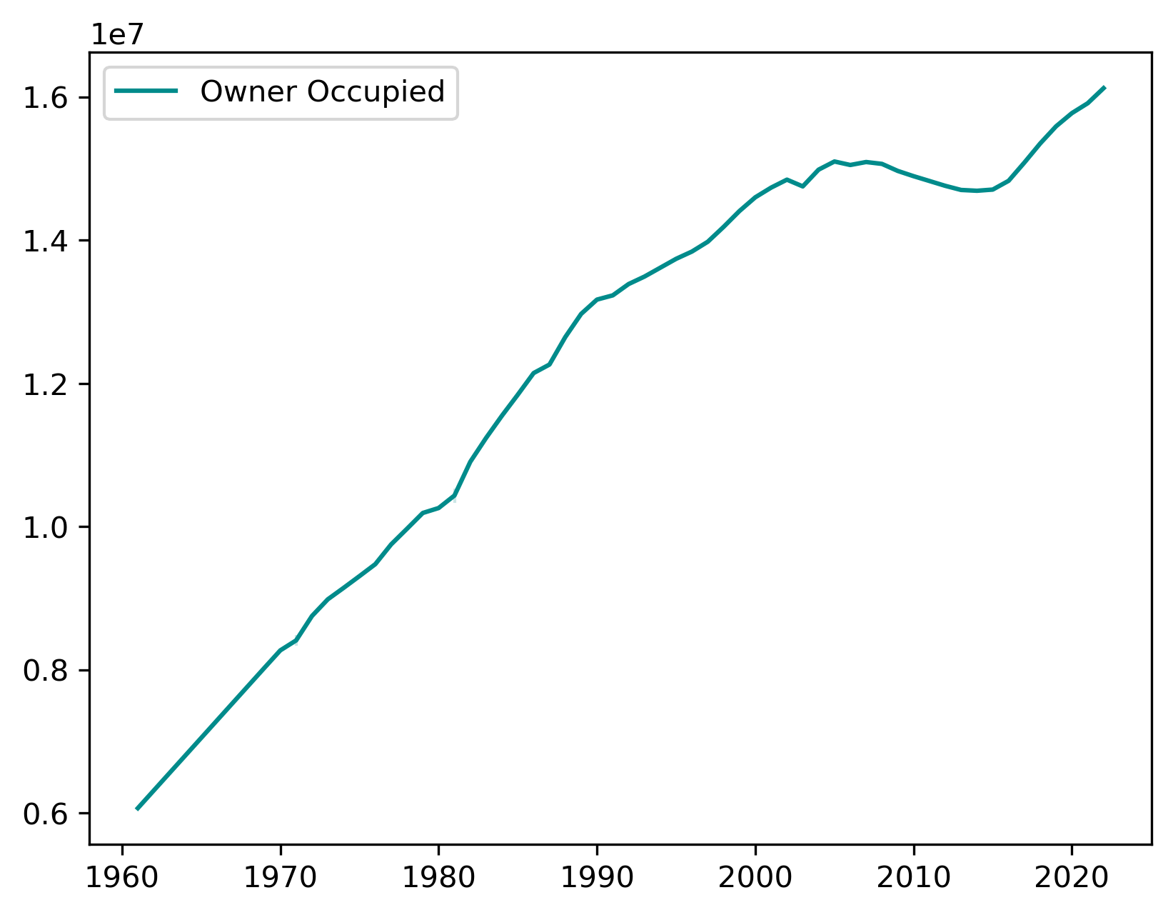
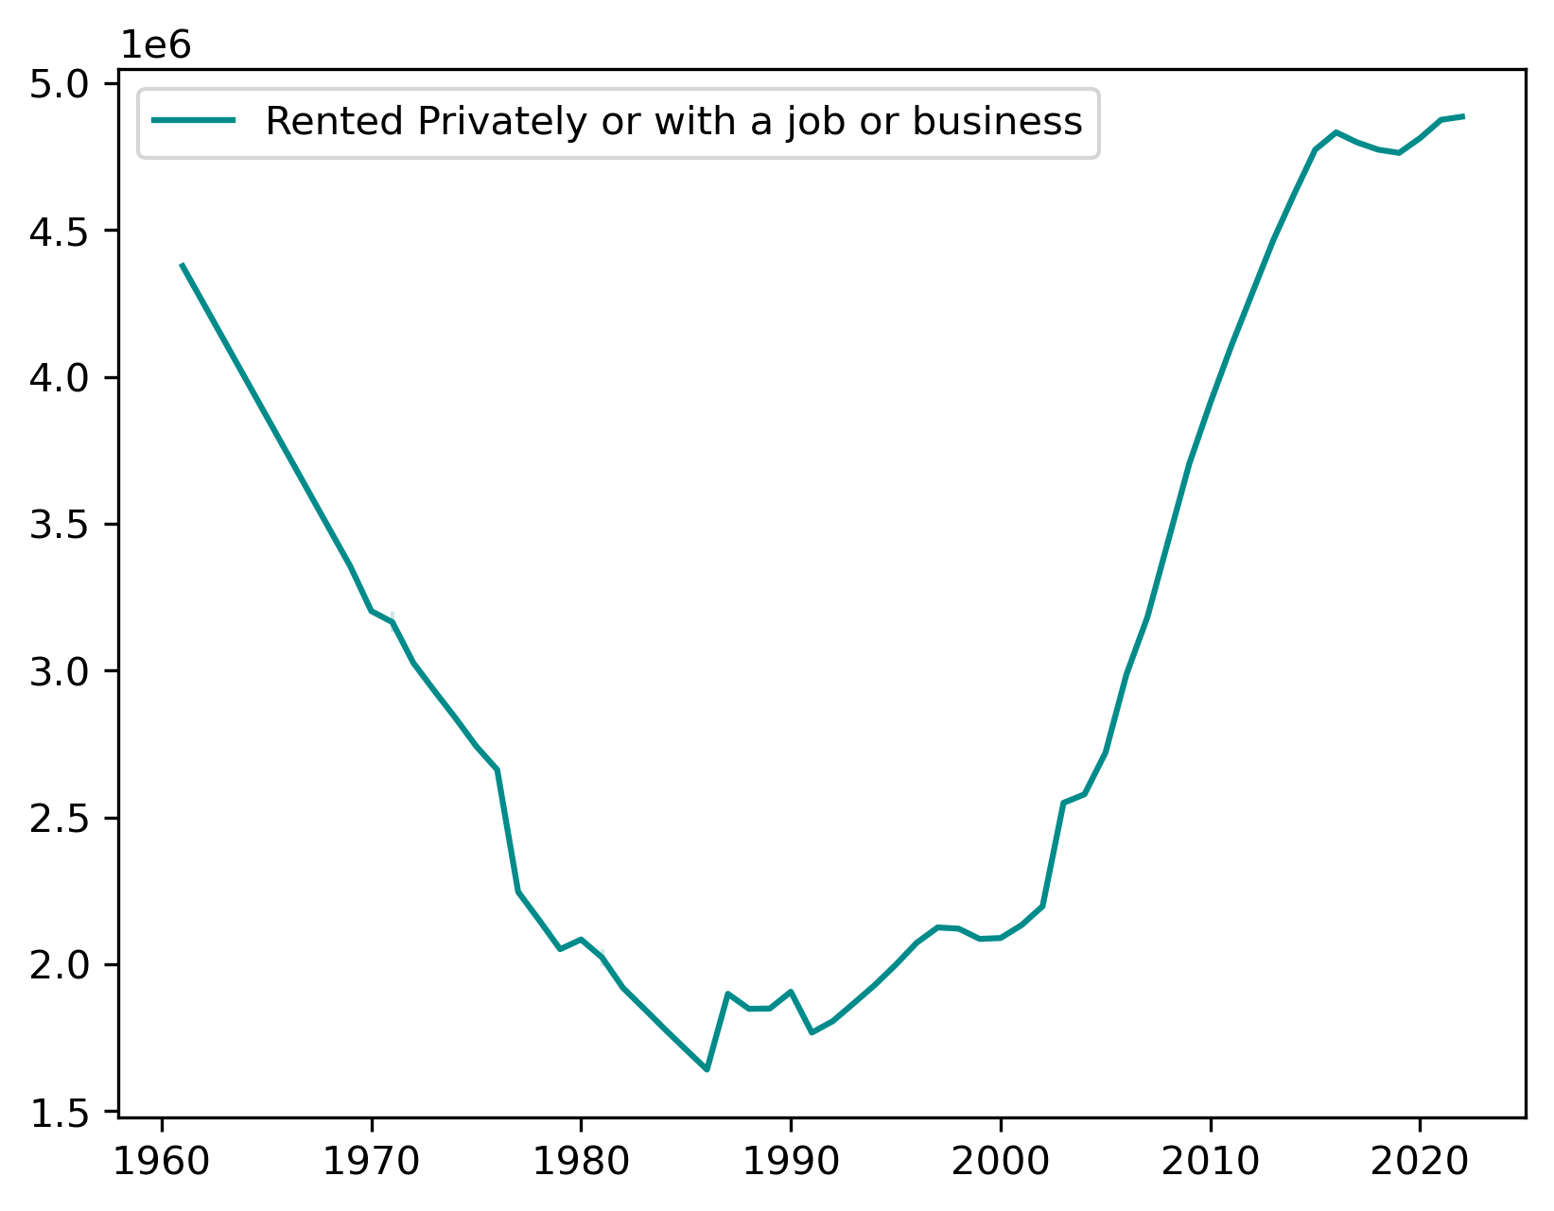
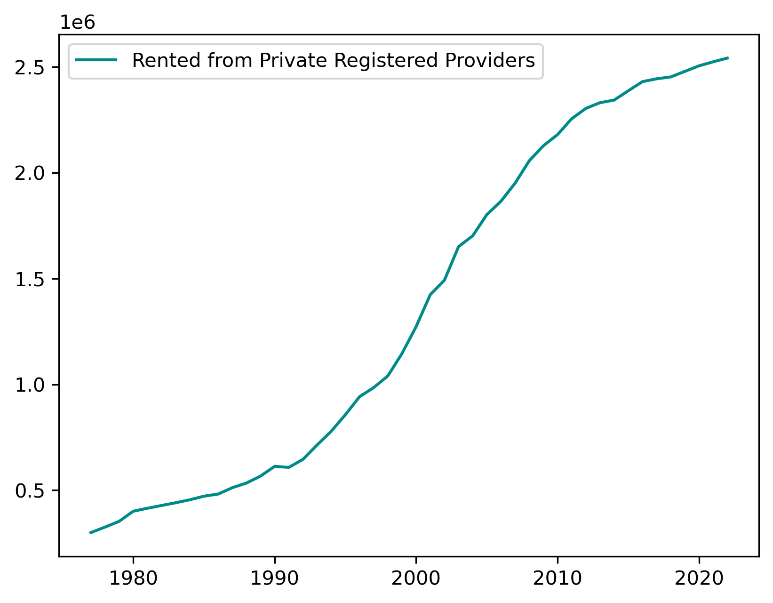
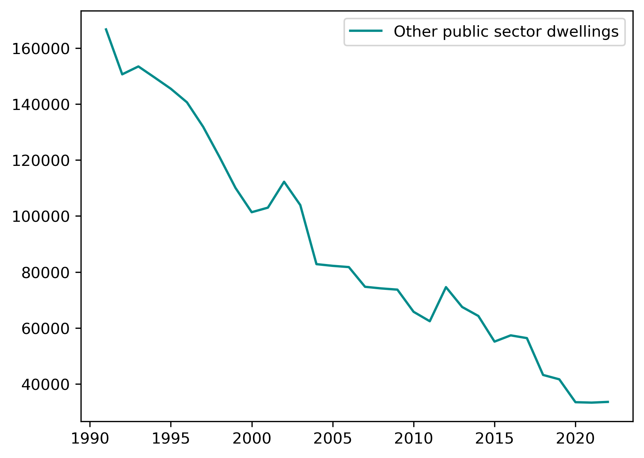
Dwelling by tenure

Slide 23
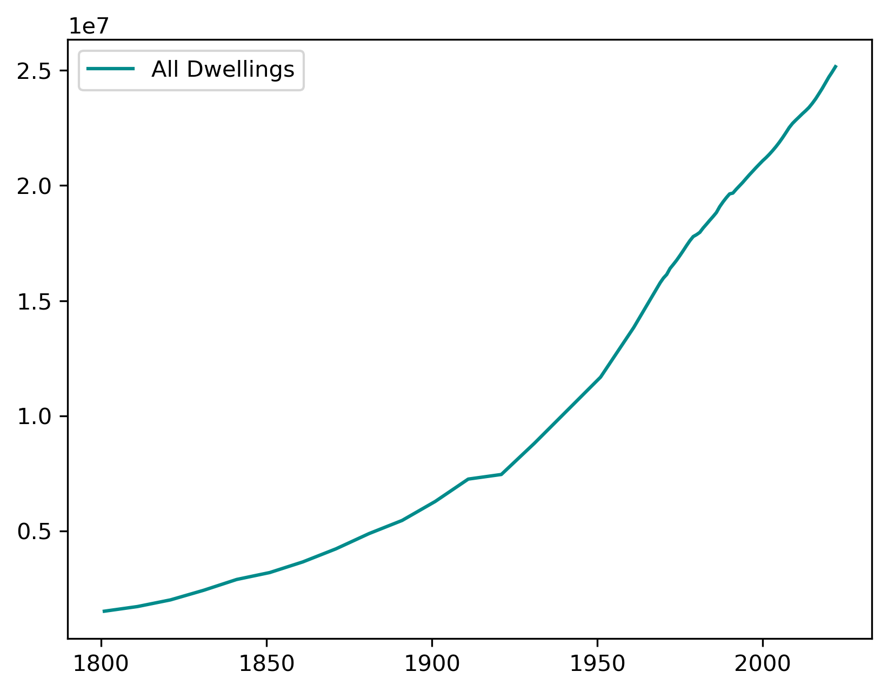

Slide 24
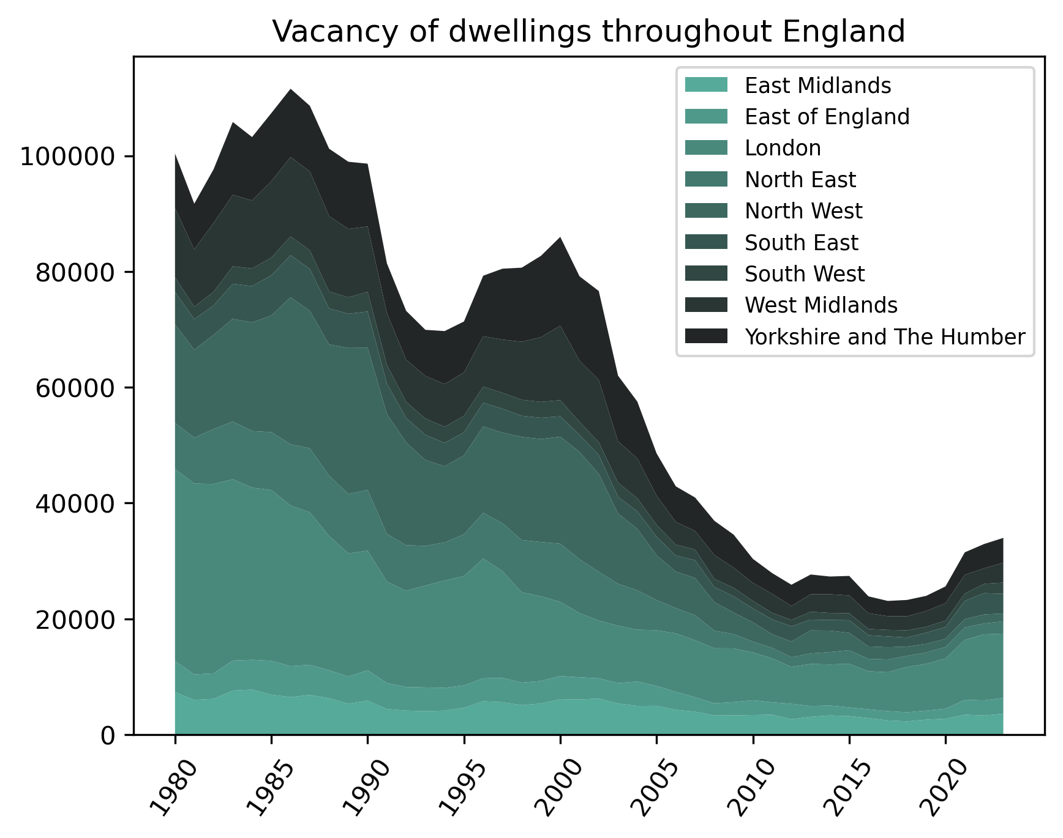

Slide 25
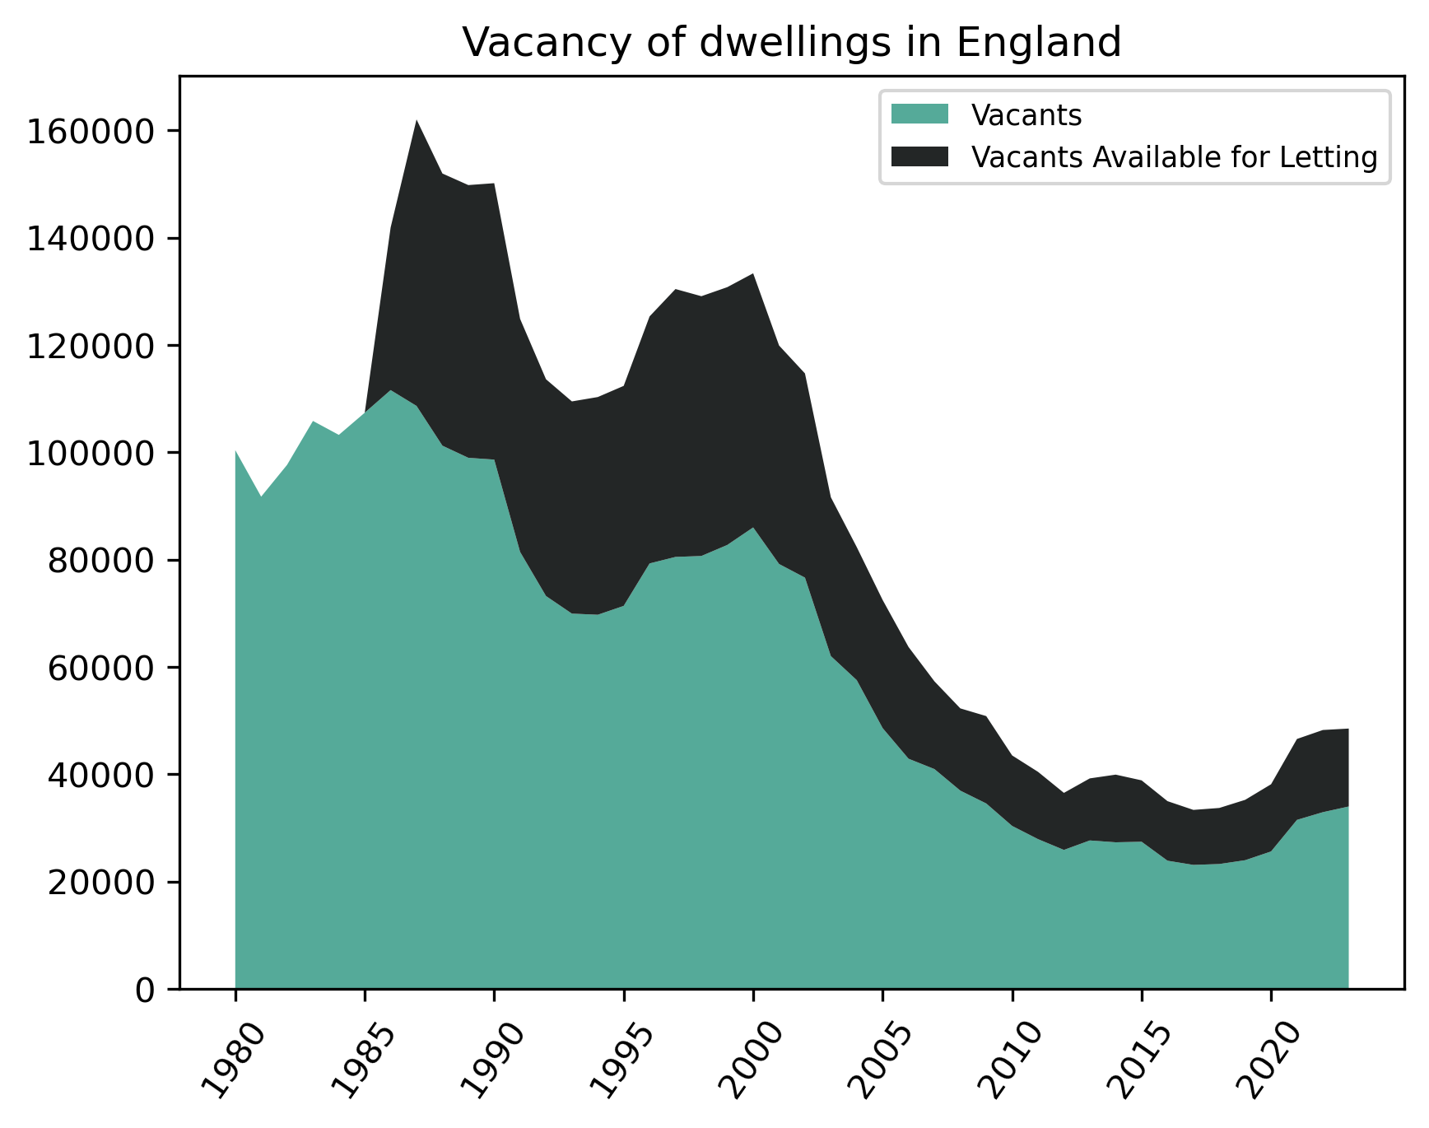
*missing # for availability between 1980 and 1985

Slide 26
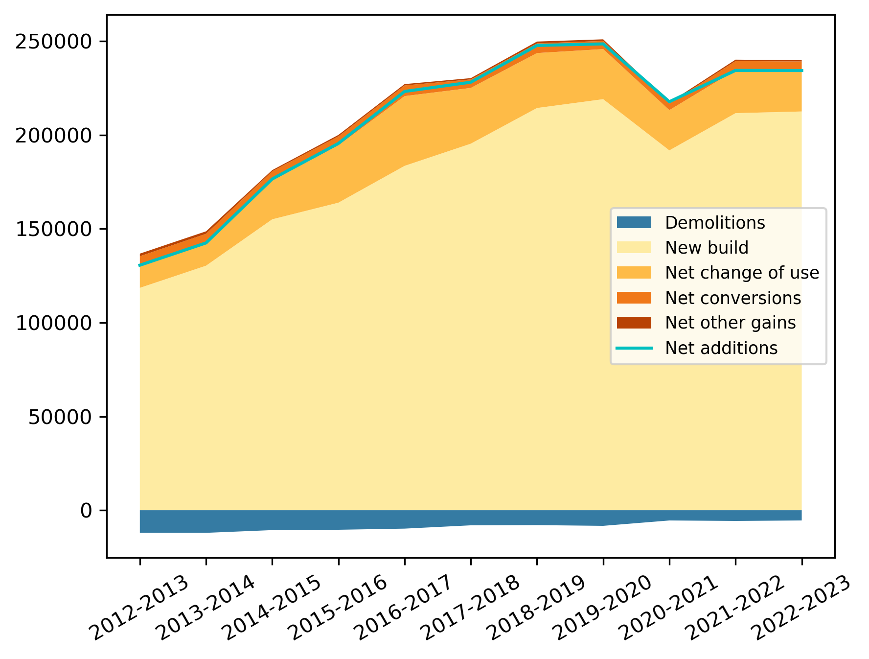

Slide 27
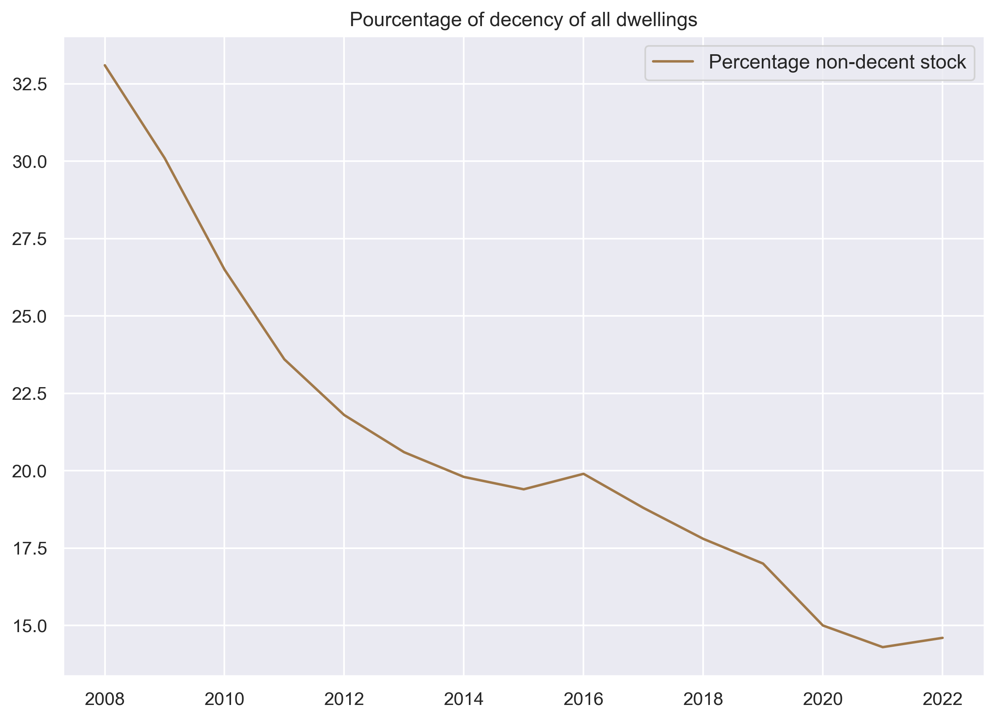

Slide 28
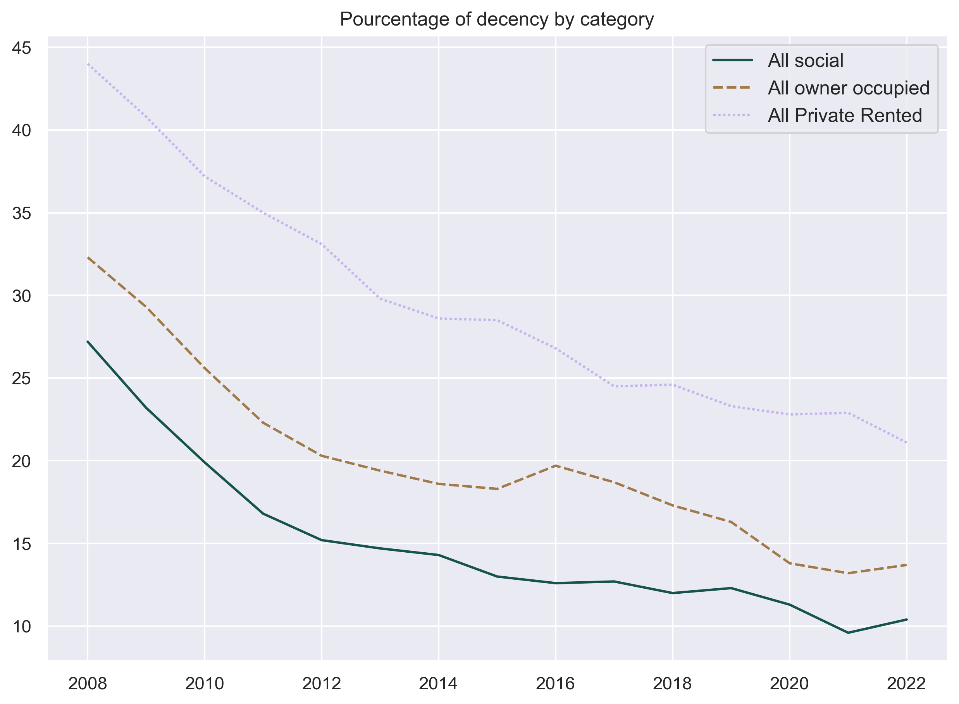

Slide 29
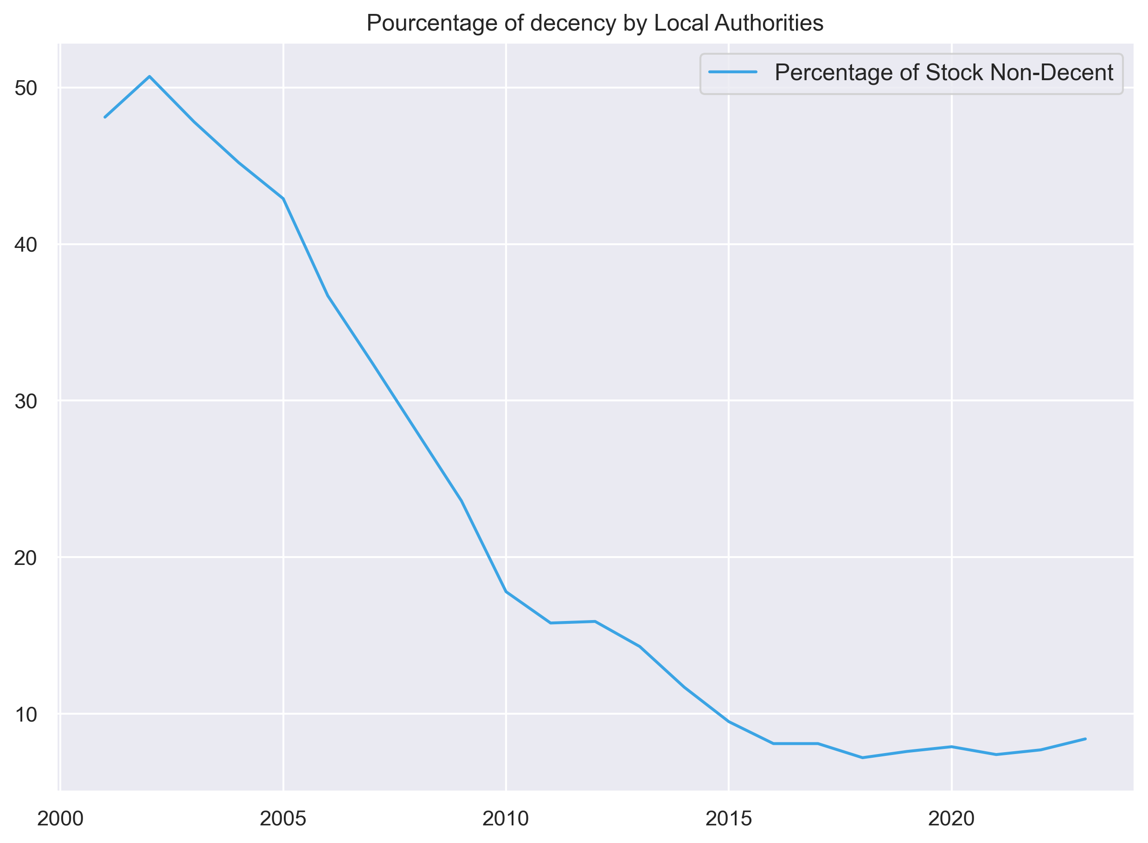

Slide 30
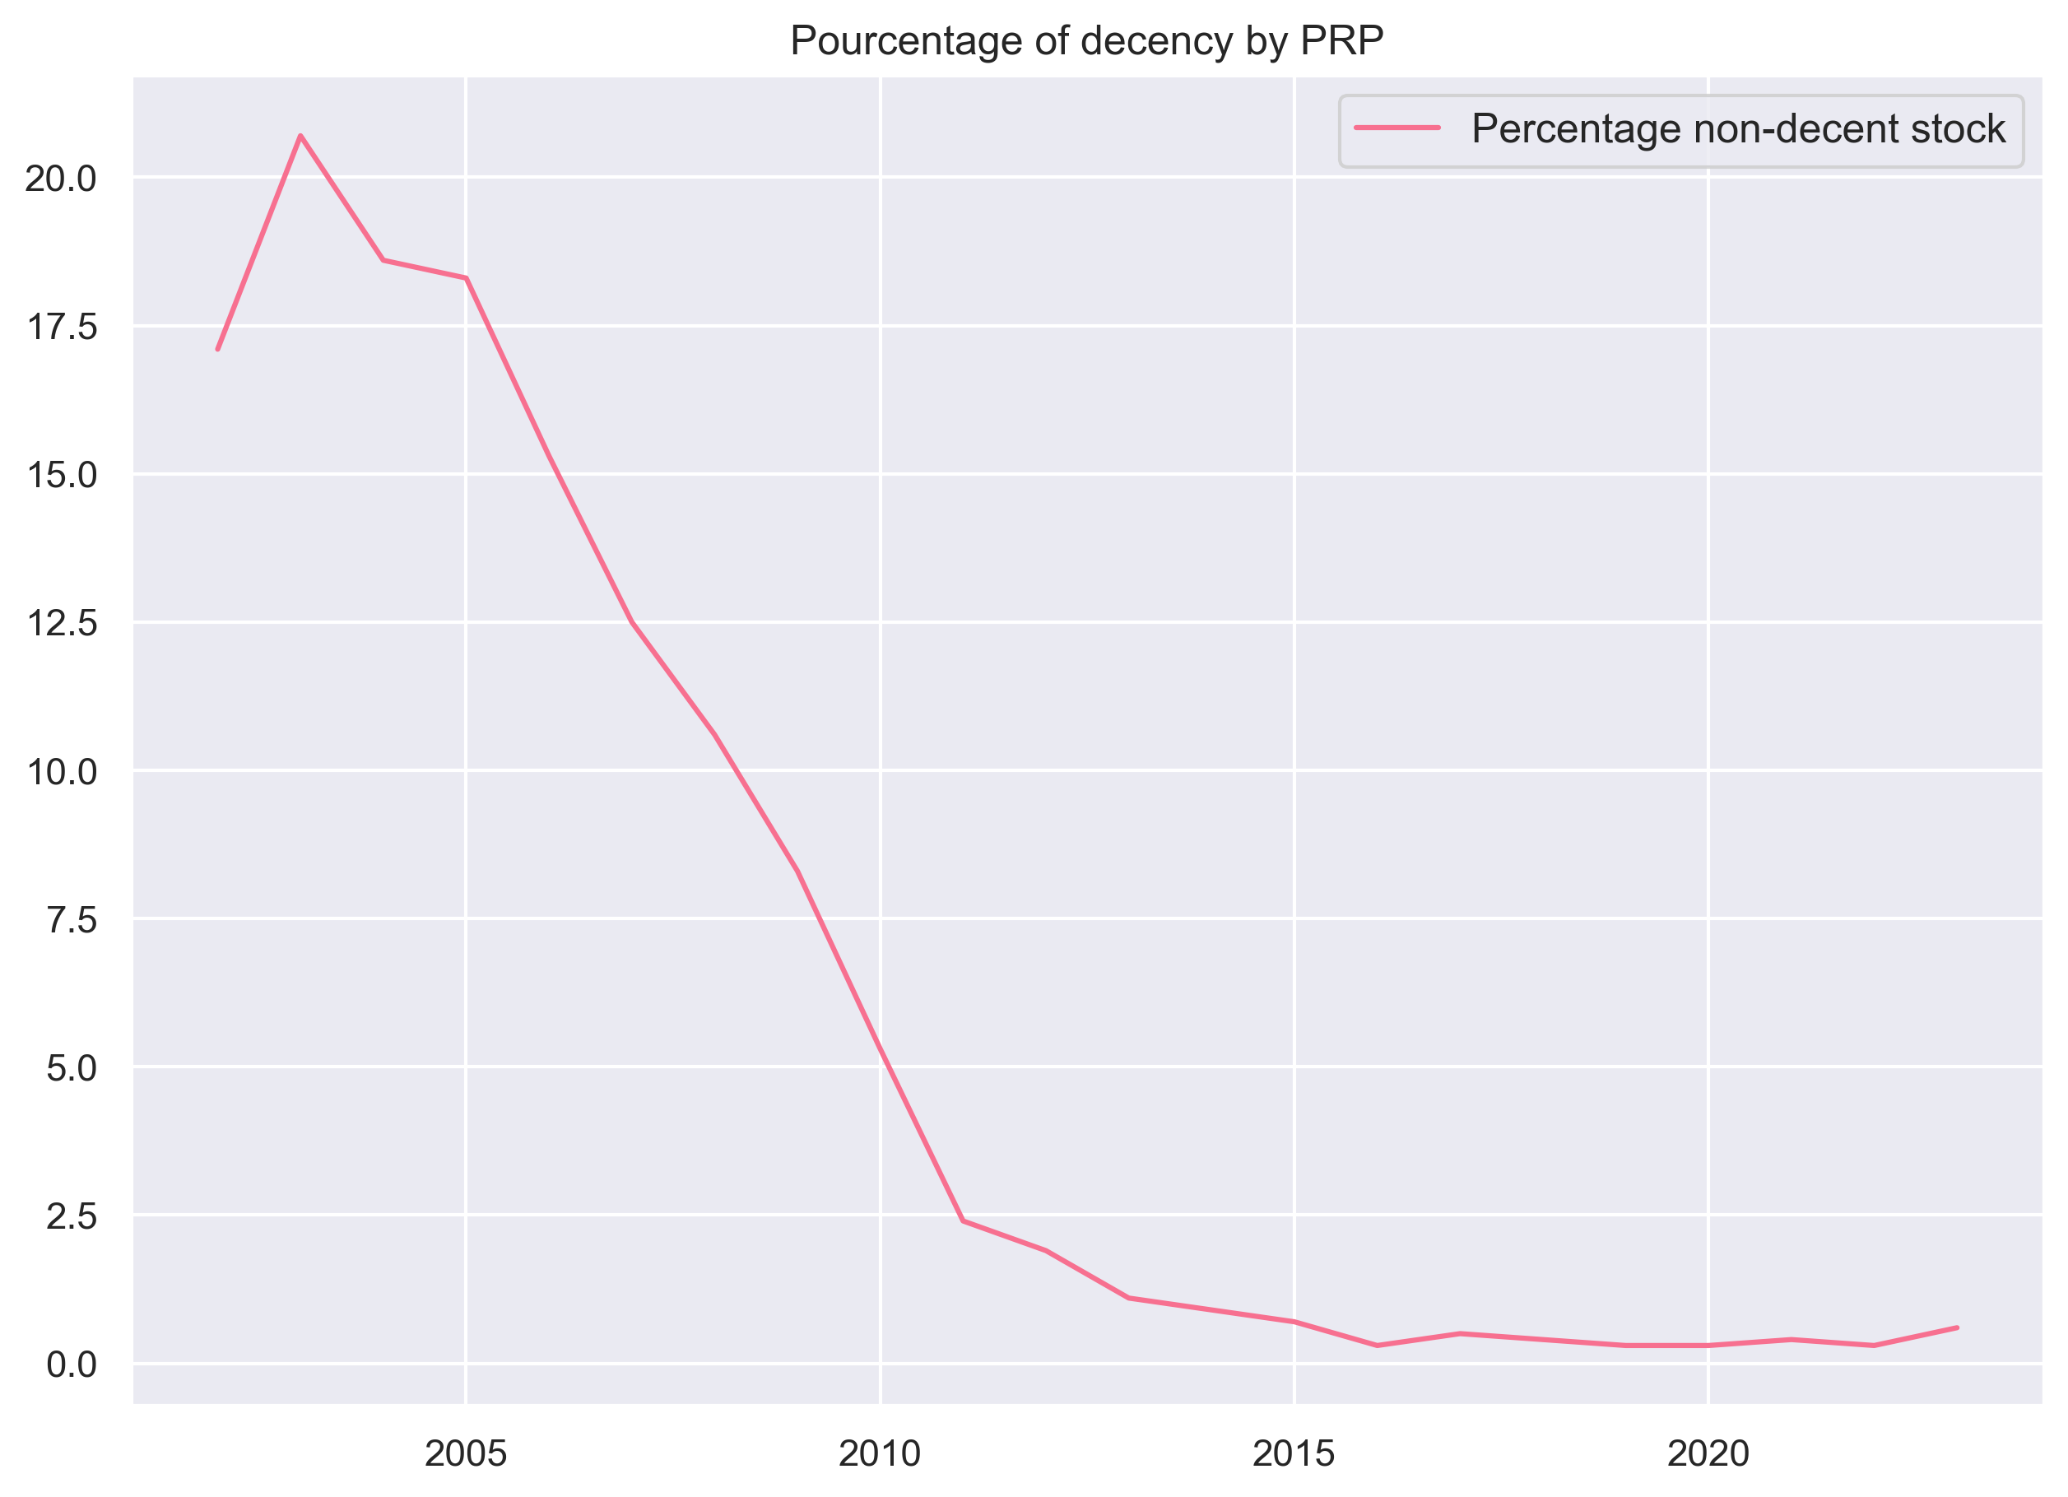

Slide 31
Energy use
ENERGY CONSUMPTION EVOLUTION
ENERGY EFFICIENCY

Slide 32
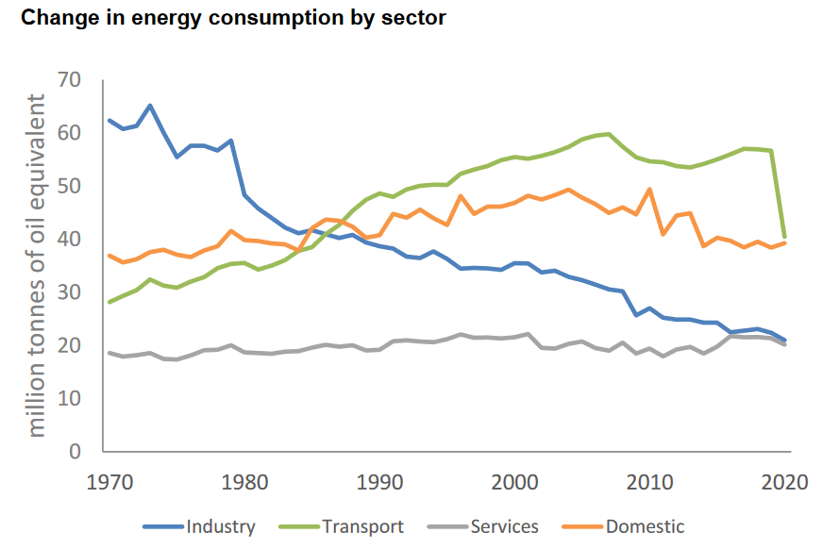
England energy CONSUMPTION

Slide 33
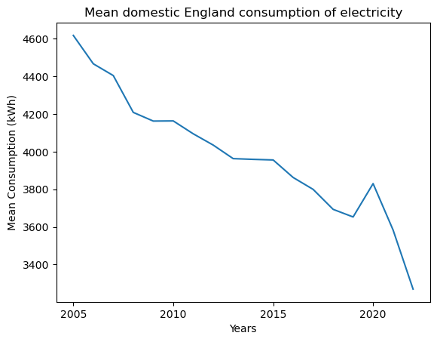
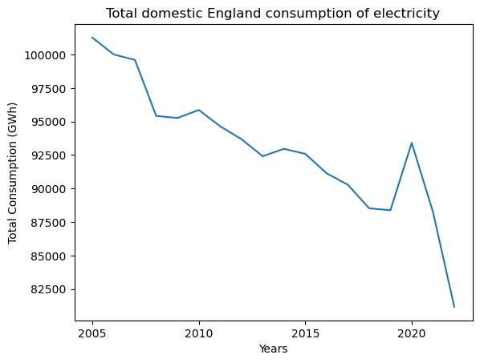
ELECTRICITY DOMESTIC CONSUMPTION

Slide 34
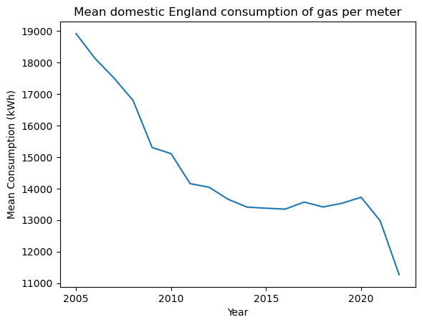
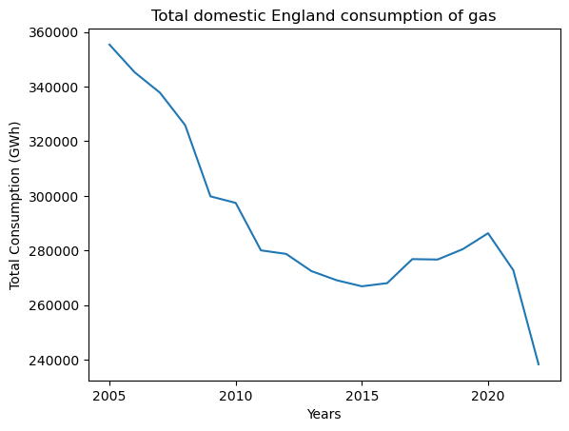
GAS DOMESTIC CONSUMPTION

Slide 35
EXPLAINATION of the decrease of the consumption
Improvement in energy efficiency
Price increased
Government and EU policies

Slide 36
Other expected results
Oil energy consumption
Evolution of energy efficiency

Slide 37

METHODS
Past (1801-2022)
& Future

Slide 38
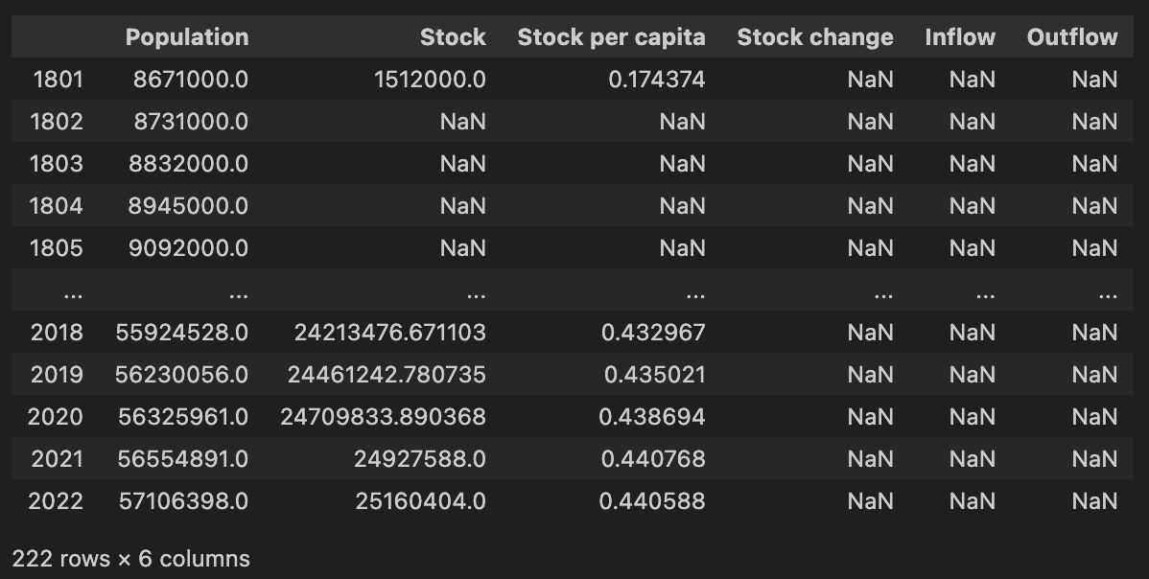
Population and (partial) stock

Slide 39
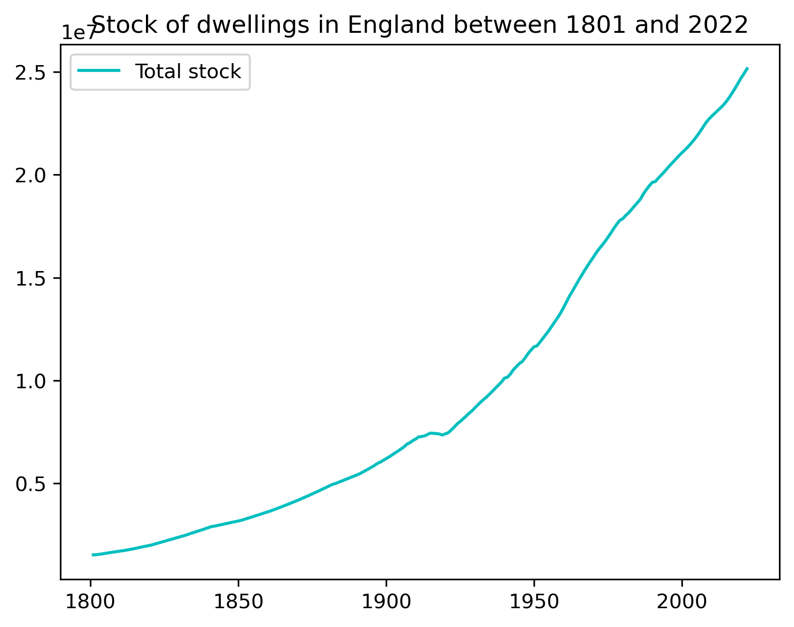
Population and (INTERPOLATED) stock
Interpolation

Slide 40
PAST DATA MODELLING
Interpolation on stock per capita
We have the stock on all the past timeframe
We calculate the stock change for 1802-2022
TBD:
Cohorts by year and type: find data concerning dwelling types
Find the right lifetime (by cohort) for fitting and regression

Slide 41
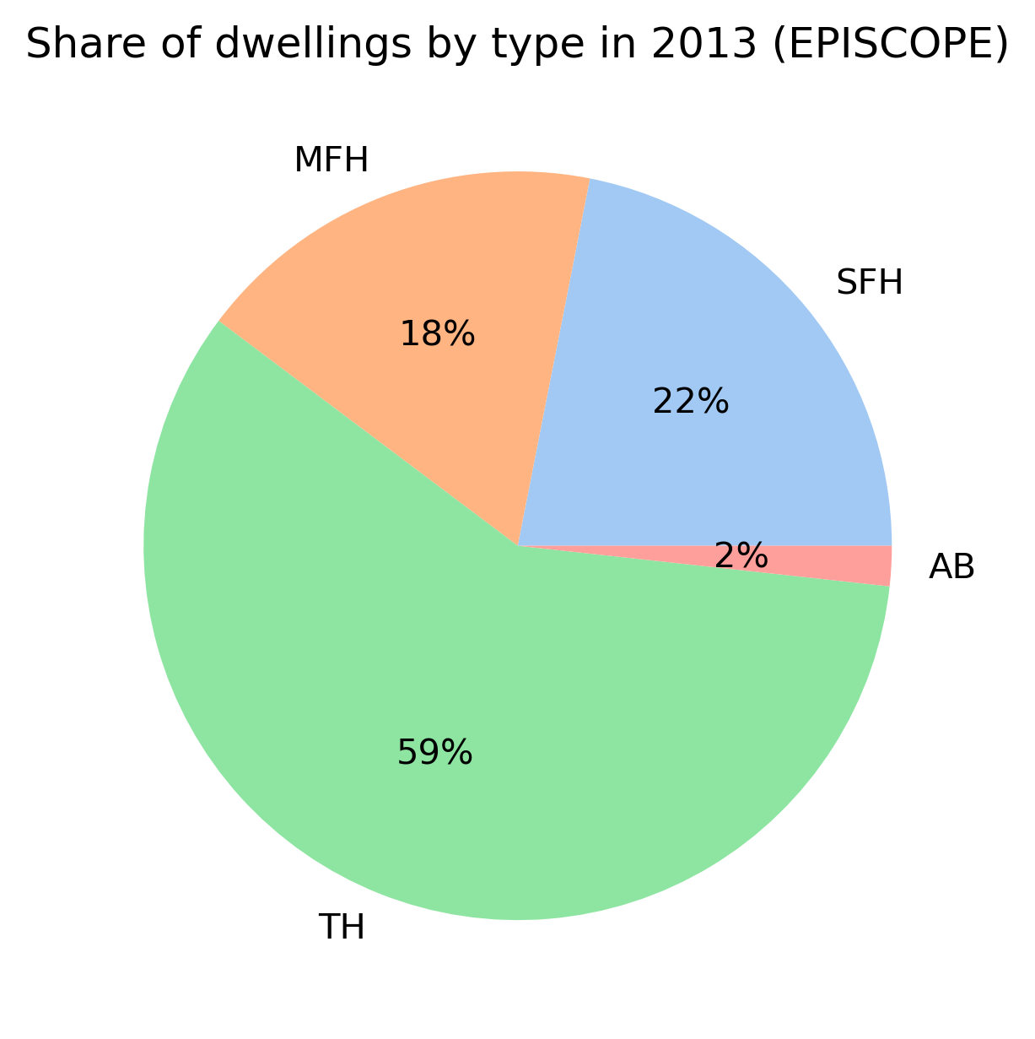
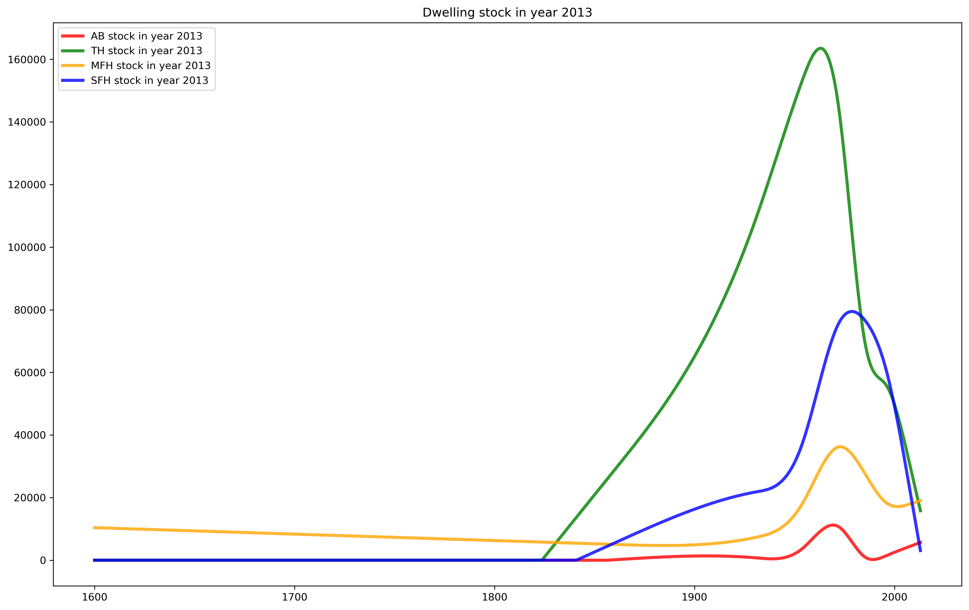
COHORT CARACTERISATION

Slide 42
FUTURE DATA MODELLING
TBD:
Integrate population projections from the ONS
Integrate the vacancy tendencies
Integrate demolition / net change of use + conversion tendencies
+ Look into plan for eventual new energy regulations

Slide 43
Inflow/Outflow:
See other new data ?
Housing survey: https://www.gov.uk/government/collections/english-housing-survey
Projections : https://www.ons.gov.uk/peoplepopulationandcommunity/populationandmigration/populationprojections/datasets/householdprojectionsforengland
Projections : https://www.ons.gov.uk/peoplepopulationandcommunity/populationandmigration/populationprojections/bulletins/2016basedhouseholdprojectionsinengland/previousReleases
New supply: https://www.gov.uk/government/collections/house-building-statistics
New orders: https://www.ons.gov.uk/businessindustryandtrade/constructionindustry/datasets/newordersintheconstructionindustry
Social housing sales: https://www.gov.uk/government/statistical-data-sets/live-tables-on-social-housing-sales

Slide 44
Energy use
Energy efficiency by region
Electricity consumption by year
Gaz consumption by year

Slide 45
METHODS
Soustitre

Slide 46
Final results and interpretation
Sous
Titres

Slide 47
WORK PLAN
Soustitre

Slide 48
TITRE
Points
Points
Points

Slide 49
Navigating Q&A sessions
Know your material in advance
Anticipate common questions
Rehearse your responses
Maintaining composure during the Q&A session is essential for projecting confidence and authority. Consider the following tips for staying composed:
Stay calm
Actively listen
Pause and reflect
Maintain eye contact

Slide 50

Speaking impact
Your ability to communicate effectively will leave a lasting impact on your audience
Effectively communicating involves not only delivering a message but also resonating with the experiences, values, and emotions of those listening

Slide 51
Dynamic delivery
Learn to infuse energy into your delivery to leave a lasting impression
One of the goals of effective communication is to motivate your audience
Metric | Measurement | Target | Actual
Audience attendance | # of attendees | 150 | 120
Engagement duration | Minutes | 60 | 75
Q&A interaction | # of questions | 10 | 15
Positive feedback | Percentage (%) | 90 | 95
Rate of information retention | Percentage (%) | 80 | 85

Slide 52
Final tips & takeaways
Consistent rehearsal
Strengthen your familiarity
Refine delivery style
Pacing, tone, and emphasis
Timing and transitions
Aim for seamless, professional delivery
Practice audience
Enlist colleagues to listen & provide feedback
Seek feedback
Reflect on performance
Explore new techniques
Set personal goals
Iterate and adapt

Slide 53
Navigating Q&A sessions
Impact factor | Measurement | Target | Achieved
Audience interaction | Percentage (%) | 85 | 88
Knowledge retention | Percentage (%) | 75 | 80
Post-presentation surveys | Average rating | 4.2 | 4.5
Referral rate | Percentage (%) | 10 | 12
Collaboration opportunities | # of opportunities | 8 | 10

Slide 54
Thank you
Emrys Duclos
Tiffany Tran-Heinerich

